Slide 1

SMART INDIA HACKATHON 2026
Problem Statement ID – 26001
Problem Statement Title-
AI-Based early warning and landslide
Risk Monitoring System in NER
Theme- Disaster Management
PS Category- Software
Team ID-
Team Name – Team Drishti

Slide 2
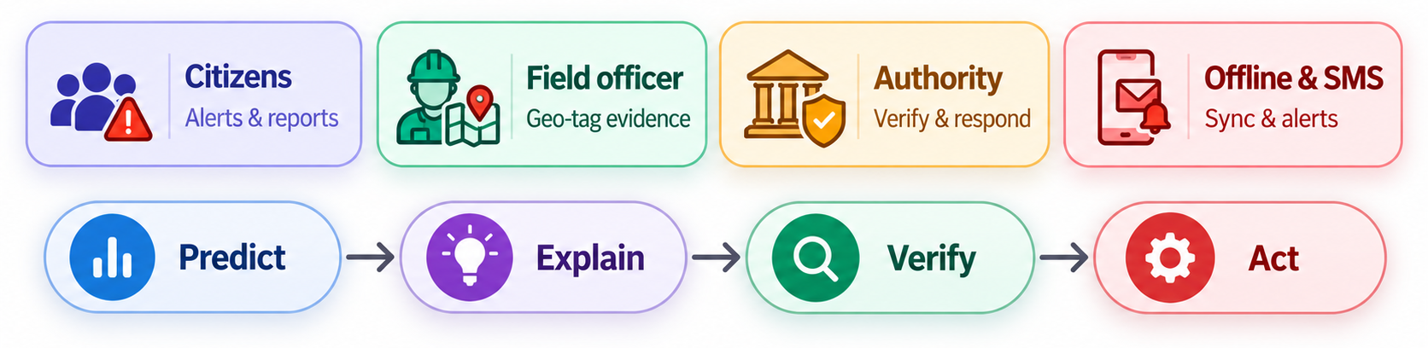
BhuRakshak AI
Team
Drishti
SOLUTION : “BhuRakshak AI turns landslide data into early warnings and action ”
BhuRakshak AI : A Web + Mobile AI platform for North-East India that uses rainfall, terrain, satellite and historical data to assess landslide risk.
Key Highlights
Predict → AI-based risk levels
Map → GIS risk zones, roads & settlements
Verify → Geo-tagged field/citizen reports
Respond→ Alerts, safety guidance& response priority
WHY IT MATTERS
Enables early risk monitoring
Combines prediction + field verification
Helps authorities prioritise high-risk areas
Supports offline reporting + SMS/push alerts

Slide 3
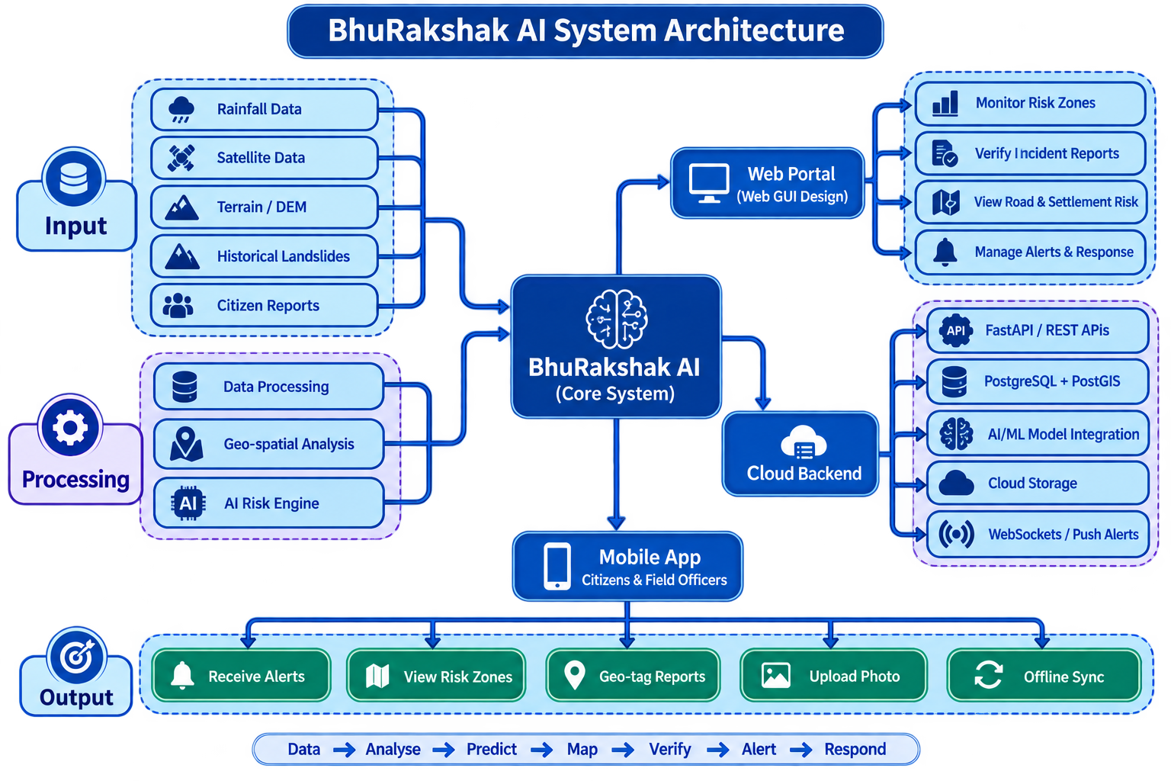

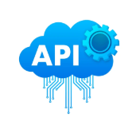




TECHNICAL APPROACH
Team
Drishti
Technologies to be Used
Web App → Next.js + OpenStreetMap
Mobile App → Capacitor.js + PostGIS
Backend → Node.js, PostgreSQL + PostGIS
AI/ML → XGBoost / Random Forest + SHAP
Alerts → Firebase Cloud Messaging + SMS Gateway
Storage/Auth → AWS S3 + JWT/Firebase Auth
Data -> Analyse -> Predict –> Map -> Verify -> Alert ->Respond

Slide 4
FEASIBILITY AND VIABILITY
Team
Drishti
Technical
AI + GIS + Web + Mobile
Data
Satellite + Weather + Historical Data as csv and json
Operational
Authority + Citizen + Field Officer
Scalability
District → State → North-East India
1. Technical Feasibility
Web + Mobile platform using Next.js Capcitor.js & node.js
AI/ML + GIS integration with cloud backend
PostgreSQL/PostGIS for location-based analysis
2. Data & Model Feasibility
Uses rainfall,terrain, satellite & historical landslide data
Multiple data sources improve prediction reliability
Model can be retrained with region-specific NER data
3. Operational Viability
Authority web portal + Citizen/Field Officer mobile app
Geo-tagged reports for ground verification
Offline storage+sync-on-reconnector low-network areas
4. Scalability & Cost
Software-first, mostly open-source technologies
Low infrastructure cost for prototype deployment
Scalable from district → state → North-East India

Slide 5
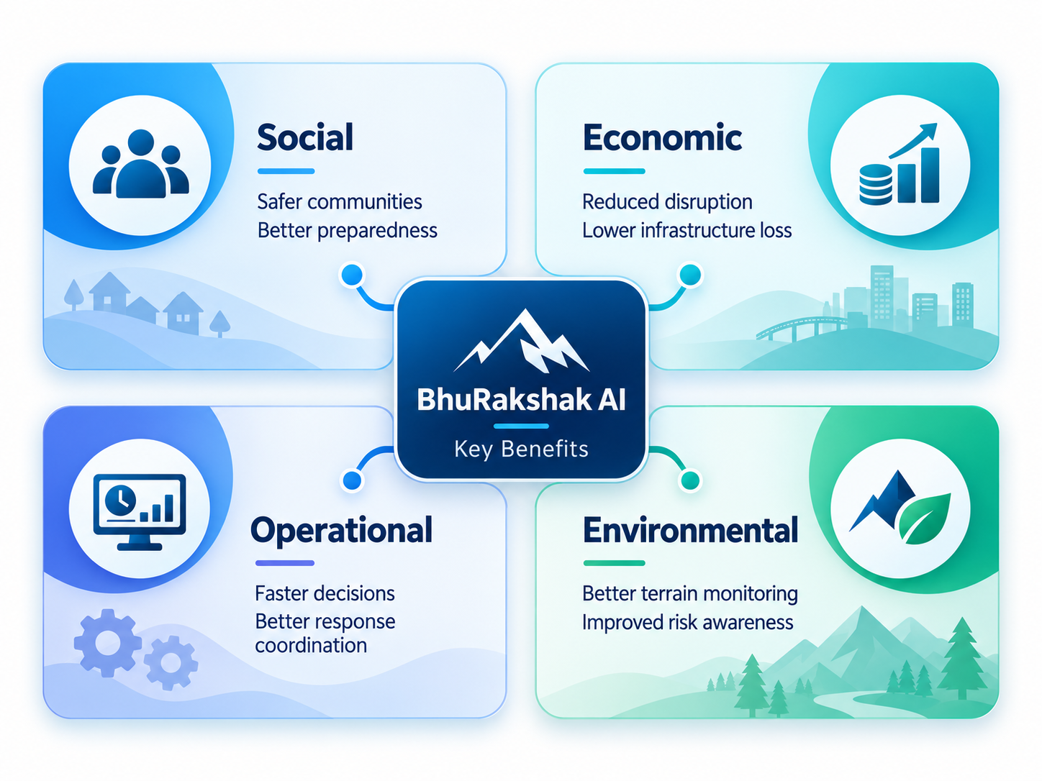
IMPACT AND BENEFITS
Team
Drishti
Before BhuRakshak ❌
Limited communication in remote regions
Delayed landslide warnings
Scattered risk and field information
Difficult to identify priority areas
Slow ground-condition verification
With BhuRakshak ✅
Early AI-based risk identification
GIS-based of roads & settlements
Real-time citizen/field reports
Faster response prioritisation
Offline reporting + push/SMS alerts
Better coordination between authorities and communities

Slide 6
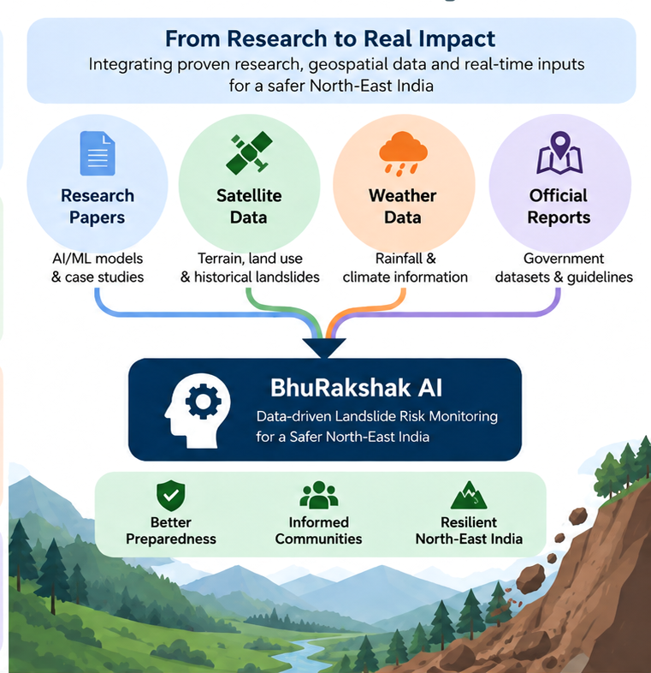
RESEARCH AND REFERENCES
Team
Drishti
Mihu, Shiv, et al. "Machine Learning-based Landslide Susceptibility Modeling in the Dibang Valley, NE India." Earth Systems and Environment (2026): 1-25. Available at :https://link.springer.com/article/10.1007/s41748-026-01036-3
Dutta, Bikash, et al. "Landslide susceptible zonation mapping of Sikkim using deterministic and machine learning approach." Advances in Space Research 76.6 (2025): 3239-3258. Available at : https://www.sciencedirect.com/science/article/pii/S0273117725007082
Jain, Nirmala, et al. Landslide Atlas of India:(Mapping, monitoring and R&D studies using remote sensing data). National Remote Sensing Centre, Indian Space Research Organisation, Department of Space, 2023. Available at :Landslide Atlas of India: Mapping, Monitoring and R&D studies using Remote Sensing data

